Slide 1
Microsoft SQL Server Analysis Services

Slide 2
Day 1/4
Create Data Source
Create Data Source View

Slide 3
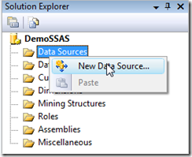
Create Data Source
1.In Solution Explorer, right-click Data Sources, and then click New Data Source.
The Data Source Wizard opens.

Slide 4
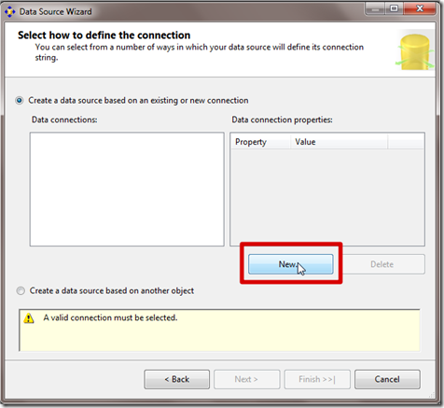
Create Data Source
2.On the Welcome to the Data Source Wizard page, click Next..

Slide 5
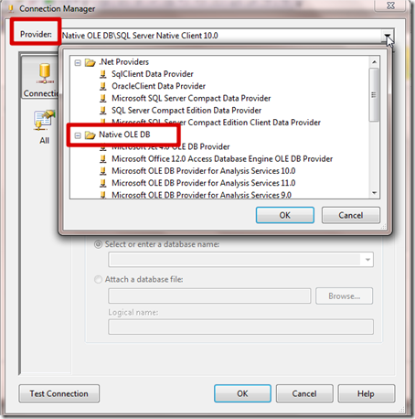
Create Data Source
3.In the Provider list, verify that Native OLE DB\SQL Native Client is selected.

Slide 6
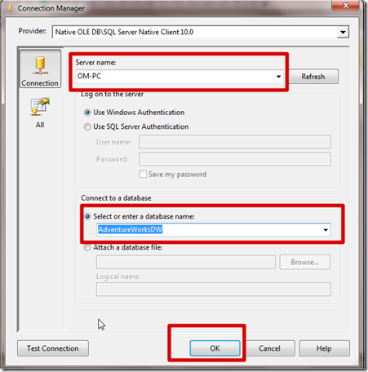
Create Data Source
4.In the Server name text box, type localhost or your Server Name

Slide 7
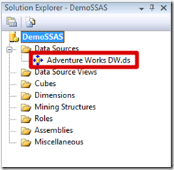
Create Data Source
4.In the Server name text box, type localhost or your Server Name

Slide 8
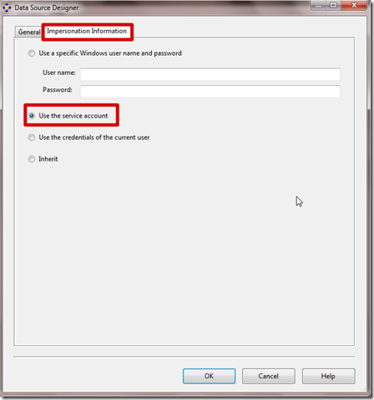
Create Data Source
5.Impersonation Information

Slide 9
Create Data Source
Impersonation Information options
Use a specific Windows username and password
Use the service account
Use the credentials of the current user
Inherit (or default)

Slide 10
Create Data Source
Use a specific Windows user name and password
This option uses the security credentials of a specified Windows user account.
The recommended impersonation setting is to specify a Windows username and password. If your server is joined to a domain, you will have to specify DOMAIN\Username in the User name textbox and the associated password in the Password textbox as seen below:
Use the service account
It will use the account used to start the Analysis Services instance to authenticate against your data source. In this case, the service account will need read access to the data source. Keep in mind that the system service accounts Network Service, Local System and Local Service will not have access to your data source if the data source is on a different server

Slide 11
Create Data Source View
Use the credentials of the current user
Select this option to have the Analysis Services object use the security credentials of the current user.
Inherit
Select this option to use the impersonation behavior, defined at the database level, which has been set by the server administrator using the DataSourceImpersonation database property.

Slide 12
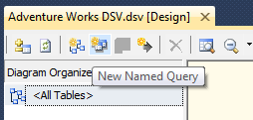
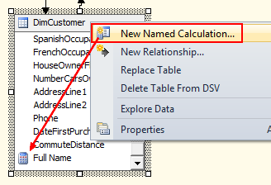
Data Source View
Named queries
Named queries create a data table with a SQL statement definition (from one or more data sources).
Named calculations
Named calculations are extra table columns made from an expressions

Slide 13
Cube Storage Modes
MOLAP (Multidimensional OLAP)
This is the default and most frequently used storage mode. In this mode when you process the cube, the source data or detailed level data get pulled from the relational store, the required aggregation is then performed and finally the data is
stored in the Analysis Services server in a compressed and optimized multidimensional format.
Once the data from the underlying relational database is retrieved there no connection exists to the relational data stores. So if there is any subsequent changes in the relational data after processing that will not reflect in the cube unless the cube is reprocessed and hence it is called offline data-set mode.
Since both the detail and aggregate data are stored locally on the OLAP server(Multidimensional Database) the MOLAP storage mode is very efficient and provides the fastest query performance

Slide 14
Cube Storage Modes
Advantage of MOLAP (Multidimensional OLAP)
Stores the detail and aggregate data in the OLAP server in a compressed
multidimensional format; as a result the cube browsing is fastest in this mode.
Provides maximum query performance, because all the required data (a copy of the detail data and calculated aggregate data) are stored in the OLAP server itself and
there is no need to refer to the underlying relational database.
All the calculations are pre-generated when the cube is processed and stored
locally on the OLAP server hence even the complex calculations, as a part the
query result, will be performed quickly.
MOLAP uses compression to store the data on the OLAP server and so has less storage requirements than relational databases for same amount of data. (Note however, that beginning with SQL Server 2008 you can use data compression at relational database level as well).

Slide 15
Cube Storage Modes
Disadvantage of MOLAP (Multidimensional OLAP)
With MOLAP mode, you need frequent processing to pull refreshed data after last
processing resulting in drain on system resources.
MOLAP stores a copy of the relational data at OLAP server and so requires dditional
investment for storage.

Slide 16
Cube Storage Modes
ROLAP (Relational OLAP)
ROLAP does not pull data from the underlying relational database source to the OLAP server but rather both cube detail data and aggregation stay at relational database source.
In order to store the calculated aggregation the database server creates additional database objects (indexed views). In other words, the ROLAP mode does not copy
the detail data to the OLAP server, and when a query result cannot be obtained
from the query cache the created indexed views are accessed to provide the
results.

Slide 17
Cube Storage Modes
Advantage of ROLAP
Ability to view the data in near real time. Since ROLAP does not make another copy of data as in case of MOLAP, it has less storage requirements.
ROLAP mode, the detail data is stored on the underlying relational database, so
there is no limitation on data size that ROLAP can support or limited by the
data size of relational database. In nutshell, it can even handle huge volumes
of data.

Slide 18
Cube Storage Modes
Disadvantage of ROLAP
Compared to MOLAP or HOLAP the query response is generally slower because everything is stored on relational database and not locally on the OLAP server.
Permanent connection to the underlying database must be maintained to view the
cube data.

Slide 19
Cube Storage Modes
HOLAP (Hybrid OLAP)
This mode is a hybrid of MOLAP and ROLAP and attempts to provide the greater data capacity of ROLAP and the fast processing and high query performance of MOLAP.
In HOLAP storage mode, the detailed level or Source data remains in the underlying relational data store and the aggregations are stored on the OLAP server.
If you query only summary data in aggregation, the HOLAP storage mode will work similar to MOLAP.
For the detail data queries, HOLAP will drill through the detail data in underlying relational data store and hence performance would not be as good as MOLAP.

Slide 20
Cube Storage Modes
Advantage of HOLAP
HOLAP balances the disk space requirement, as it only stores the aggregate data on
the OLAP server and the detail data remains in the relational database. So no
duplicate copy of the detail data is maintained.
HOLAP does not store detail data on the OLAP server, the cube and partitions
would be smaller in size than MOLAP cubes and partitions.
HOLAP would be optimal in the scenario where query response is required and query results are based on aggregations on large volumes of data.

Slide 21
Cube Storage Modes
Disadvantage of HOLAP
Query performance (response time) degrades if it has to drill through the detail data
from relational data store, in this case HOLAP performs very much like ROLAP.

Slide 22
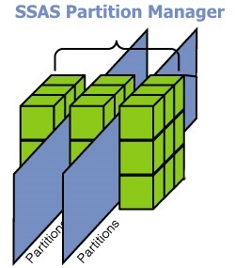
Partition and Aggregation
Partition:
A partition is a physical unit of storage that contains a subset of the Analysis Services database data.
By default, every measure group has a single partition containing the entire data. When you create multiple partitions, the measure group represents the combined data stored in all its partitions.
Analysis Services stores both Fact (detail) and summarized (aggregated) data in each partition. It also stores aggregation design, Proactive caching settings, etc. in each partition.

Slide 23
Partition and Aggregation
Why partitions?:
Partitions can be spread across multiple physical drives allowing parallel data access which Analysis Services can access data in multiple drives at the same time.
This is an excellent option that will improve query response time.
For example, let’s say you have a cube with yearly partitions, since the partition for the current year is most likely to be queried often, you will want to create a higher aggregation design for that partition. With higher aggregation design, Analysis Services will create higher number of aggregations (pre-calculated summaries of data) instead of computing them at run time, thus improving the query response time.
Partitions can be processed independently.
For example, if you have yearly partitions (which is quite common) you can save a lot of processing time by processing only the current year partition when data is added to the cube. Since data in previous year partitions generally will not change, you can leave them as they are.

Slide 24
Partition and Aggregation
Aggregation:
Aggregations are pre-calculated summaries of data from leaf cells.
It is analogous to calculated value by GROUP BY statements of T-SQL with some attributes.
SQL Server pre-aggregates the measures with respect to dimension attributes at some extent instead of executing the query runtime. Pre-aggregation improve the query performance.
Aggregation are summarized values. Each of which corresponds to a combination of an attribute from each dimension and measure group.

Slide 25
Cube Processing Options
Process Add:
This processing mode is available for Dimensions, Measure Groups and Partitions.
When this processing mode is applied to Dimensions, it adds new members into the dimensions from the underlying database and updates the descriptions of the attributes.
When this processing mode is applied to Measure Groups and Partitions, it adds the incremental fact data into the cube and processes only the affected partitions.

Slide 26
Cube Processing Options
Process Data:
This processing mode is available for Dimensions, Measure Groups, Partitions, and Cubes.
This processing mode is used to process the data without actually building or creating the aggregations and indexes.
If there is data is in the partitions, it will be dropped before re-populating the partition with source data.

Slide 27
Cube Processing Options
Process Update:
This processing mode is available only for Dimensions. When this processing mode is used, it freshly reads all the dimension data from the database and updates the data in the dimension.
Forces a re-read of data and an update of dimension attributes. Flexible aggregations and indexes on related partitions will be dropped.

Slide 28
Cube Processing Options
Process Default:
This processing mode is available for Dimensions, Measure Groups, Partitions, Mining Models and Structures, Cubes, and OLAP (SSAS) databases.
When this process is applied to any of these objects, it first determines the current state of the object from a processing standpoint and then does the necessary processing to bring the object to current/fully processed state
for one’s that had a Process Full it will ignore them; for one’s that did not process, it may or may not touch them (it will if they were part of a dimension and the aggregations were dropped, in which case it will rebuild those aggregations and indexes via a Process Index but it won’t reprocess the data); for one’s that had a Process Data it will build out the aggregations and indexes (Process Index).

Slide 29
Cube Processing Options
Process Full:
This processing mode is available for Dimensions, Measure Groups, Partitions, Mining Models and Structures, Cubes, and OLAP (SSAS) Databases. When this processing mode is applied to an object, the object itself and all the subsequent lower level objects are fully processed.
The data is cleared from an object if it already has some previously processed data.
Process Full (which does a Process Data and Process Index behind the scenes). However, the best practice is to do a Process Data and Process Index separately instead of a Process Full, because: it is a bit faster, it reduces the stress on the server, it makes data available to end-users sooner (while a Process Index is happening, users can still query cube), and you can just run Process Index if Process Data completes but Process Index remained.

